Slide 1





Just Ask: Learning to Answer Questions from Millions of Narrated Videos
Antoine Yang, Antoine Miech, Josef Sivic, Ivan Laptev, Cordelia Schmid
Project page: https://antoyang.github.io/just-ask.html
Paper: https://arxiv.org/abs/2012.00451

Slide 2
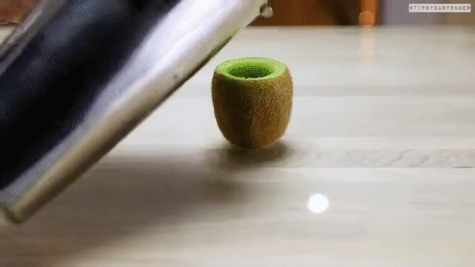
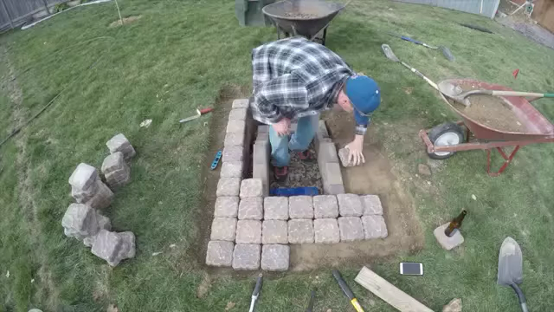
Video Question Answering (VideoQA)
VideoQA is a promising task to evaluate the ability to understand visual data.
Question: What fruit is shown at the end?
Answer: watermelon
Question: What is the largest object at the right of the man?
Answer: wheelbarrow
Source of the examples: iVQA dataset, see Slide 10

Slide 3
Challenges in VideoQA
Large diversity of questions and videos
Manual annotation for VideoQA is expensive
Problematic: How to tackle VideoQA with the least amount of manual supervision possible?
VideoQA
Model
Manually annotated (video, question, answer) triplets
Training
Expensive

Slide 4
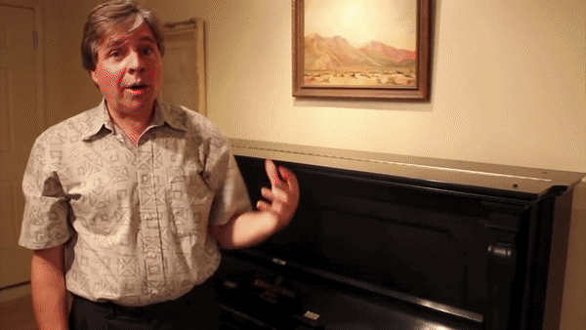
Just Ask idea
Automatically generate VideoQA training data from narrated videos.
Rely on text-only annotations and cross-modal supervision.
Speech: The sound is amazing on this piano.
Generated question: What kind of instrument is the sound of?
Generated answer: piano

Slide 5
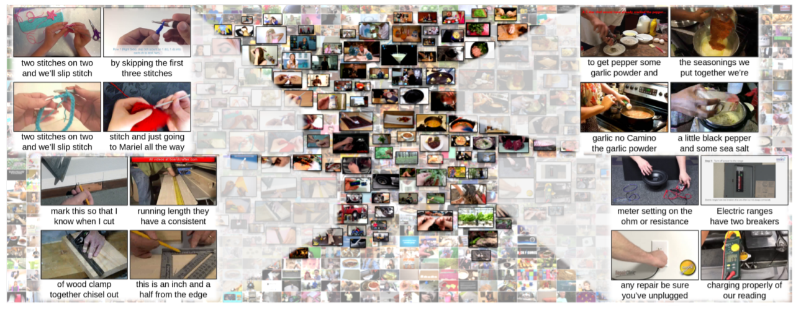
Weak supervision in narrated videos
Narrated videos are easy to obtain at scale.
Assumption: weak correlation between the visual content and the speech [Miech 2019]
[Miech 2019] HowTo100M: Learning a Text-Video Embedding by Watching Hundred Million Narrated Video Clips, Miech et al, ICCV 2019.

Slide 6
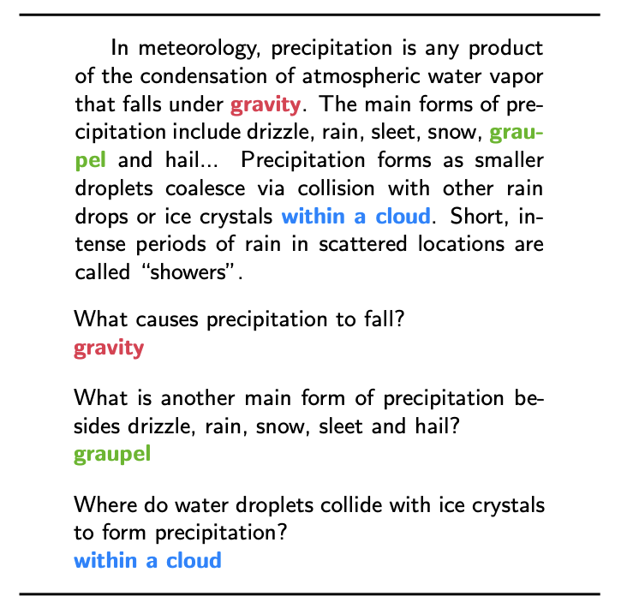
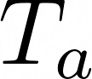
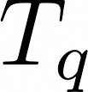
Text-only supervision
We use language models trained on a text-only question-answering corpus [Raffel 2020, Suraj 2020, Rajpurkar 2016].
Answer
extractor
Transformer
Ç√
Training
Ç√
Manually annotated
QA text corpus
Question generator
Transformer
Training
[Raffel 2020] Exploring the limits of transfer learning with a unified text-to-text transformer, Raffel et al, JMLR 2020.
[Suraj 2020] Question Generation, Suraj, GitHub repository 2020.
[Rajpurkar 2016] SQuAD: 100,000+ questions for machine comprehension of text, Rajpurkar et al, arXiv 2016.

Slide 7

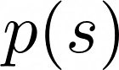
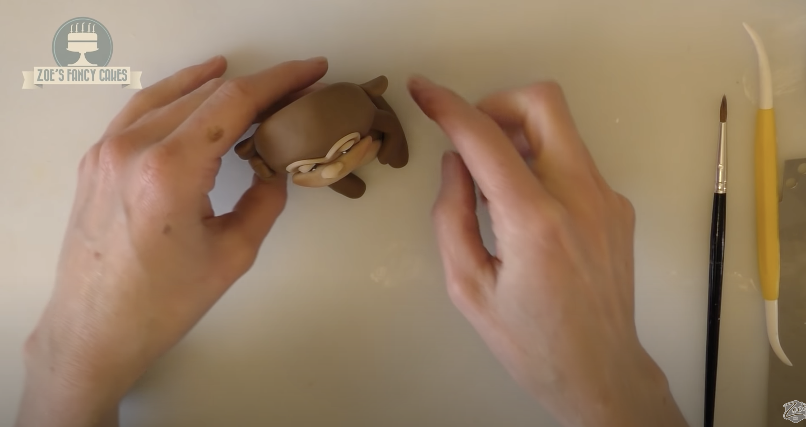
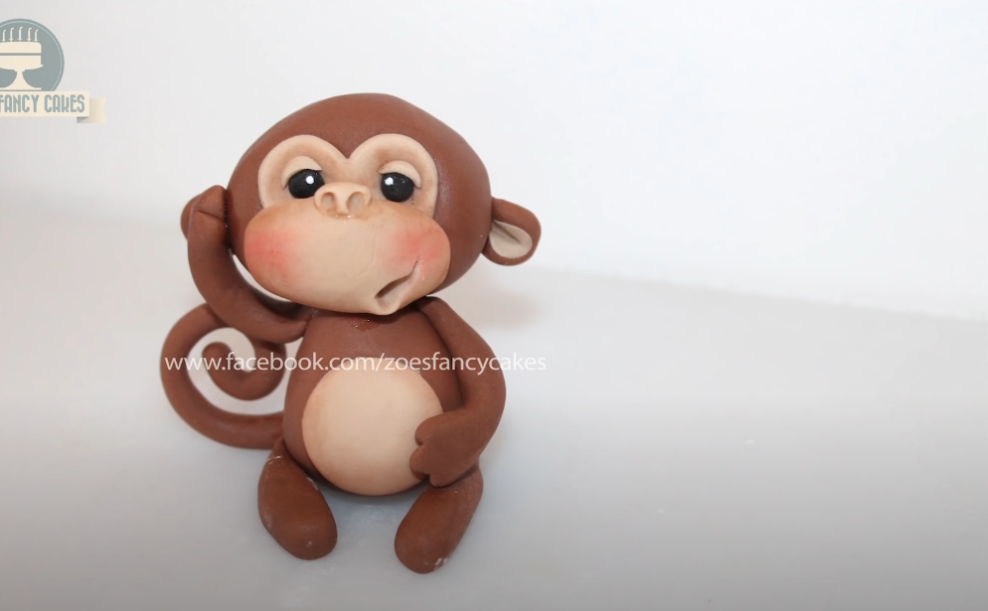

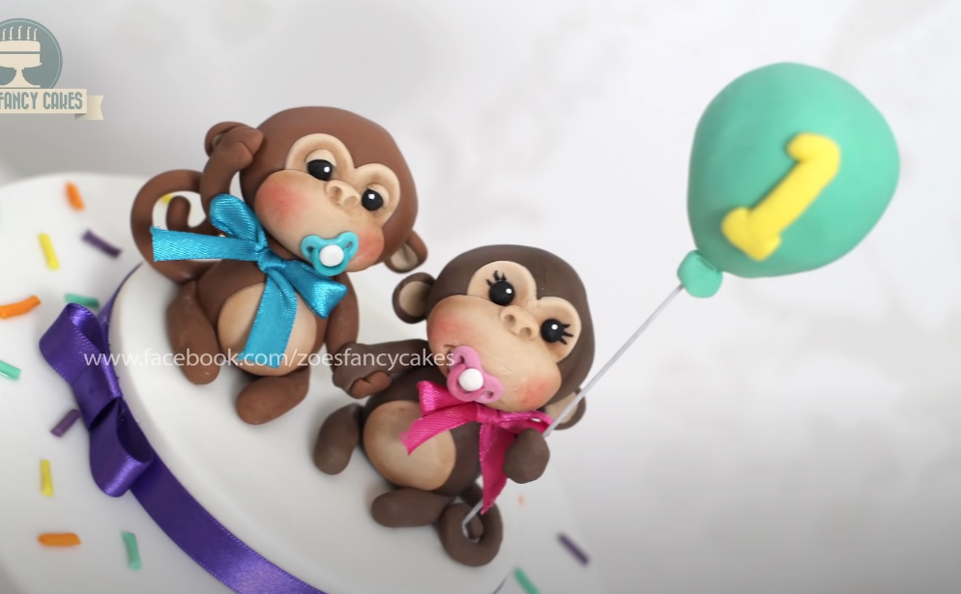

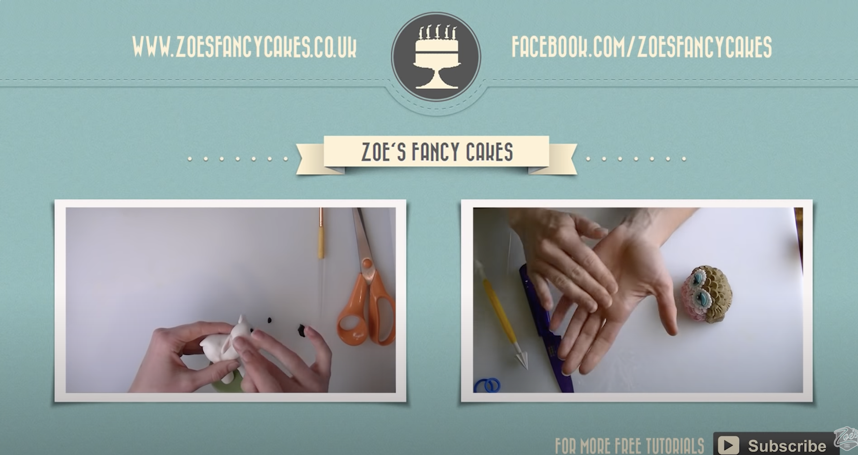


Generating VideoQA data
Raw narration
Extracted sentence
Answer
extractor
“to dry before you
stick him on a kick I”
“I put up some pictures of
him with another monkey.”
Question generator
“put up some pictures
of him with another”
Outputs
“Monkey”
Sentence
extractor
Extracted answer
“monkey as well so
you can make many”
“What animal did I put up
pictures of him with?”
[Tilk 2016]
Generated question
“as you like thank
you for watching”
start time
end time
Sentence-aligned video
[Tilk 2016] Bidirectional recurrent neural network with attention mechanism for punctuation restoration, Tilk et al, Interspeech 2016.

Slide 8
Generating VideoQA data
Raw narration
Extracted sentence
Answer
extractor
“to dry before you
stick him on a kick I”
“I put up some pictures of
him with another monkey.”
Question generator
“put up some pictures
of him with another”
Outputs
“Monkey”
Sentence
extractor
Extracted answer
“monkey as well so
you can make many”
“What animal did I put up
pictures of him with?”
[Tilk 2016]
Generated question
“as you like thank
you for watching”
start time
end time
Sentence-aligned video
[Tilk 2016] Bidirectional recurrent neural network with attention mechanism for punctuation restoration, Tilk et al, Interspeech 2016.

Slide 9
HowToVQA69M: a large-scale VideoQA dataset
Generated by applying our pipeline to HowTo100M [Miech 2019]
69M video-question-answer triplets

Slide 10
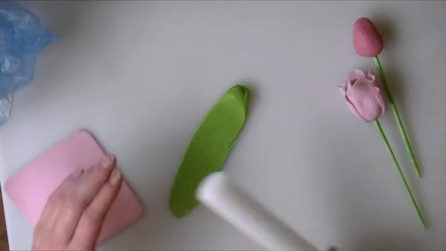
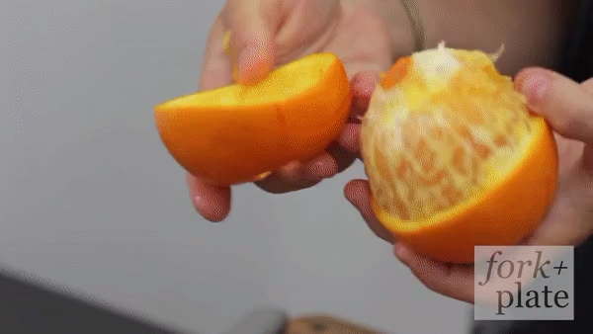
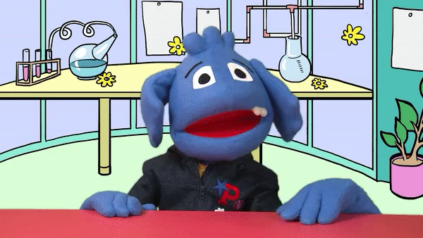

Noise in HowToVQA69M
Speech: So you bring it to a point and we'll, just cut it off at the bottom.
Generated question: What do we do at the bottom?
Generated answer: cut it off
Speech: Do it on the other side, and you've peeled your orange.
Generated question: What color did you peel on the other side?
Generated answer: orange
Speech: You can’t miss this…
Generated question: What can’t you do?
Generated answer: miss
QA Generation error
QA unrelated to video
≈ 30%
≈ 31%
≈ 39%

Slide 11
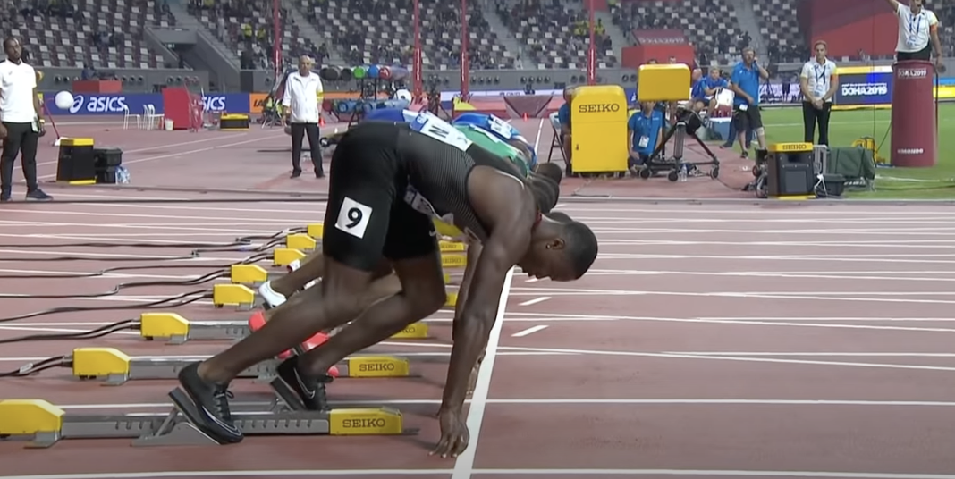
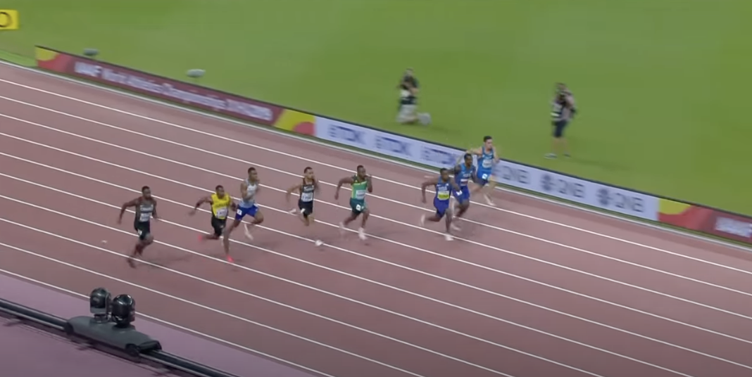
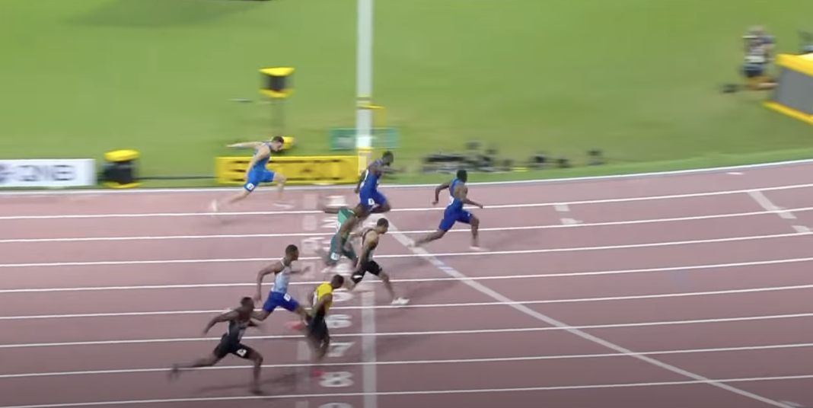
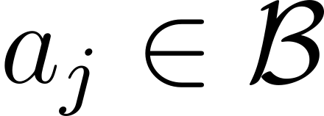
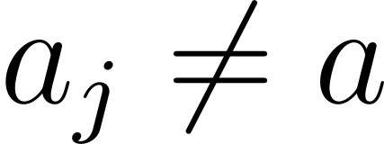
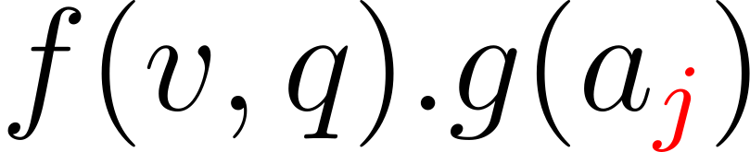
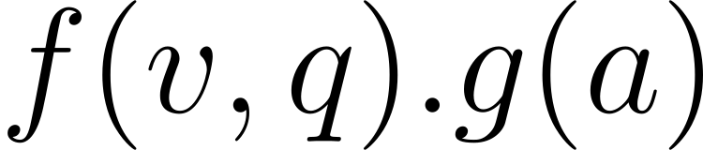
VideoQA model and training procedure

Slide 12
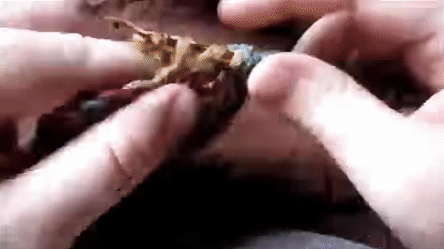
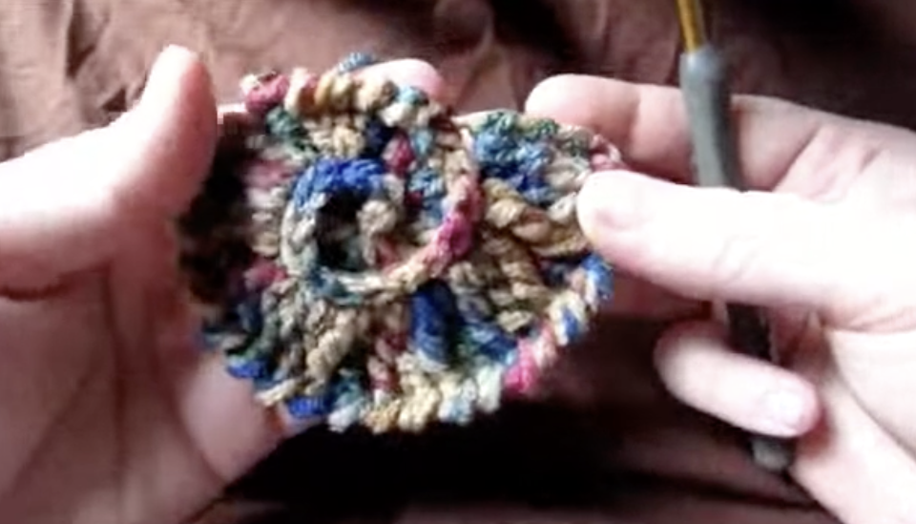

iVQA: a new VideoQA benchmark
10K videos from HowTo100M
Manually collected
10K open-ended questions
5 correct answers per question
Exclusion of non-visual questions to reduce language bias
Question: What shape is the handcraft item in the end?
shell
2 annotators
Answers
spiral
2 annotators
heart
1 annotator

Slide 13
Zero-shot VideoQA: quantitative results
Task definition: no manual supervision of visual data
Our model (iii) outperforms:
Its language-only variant (i) -> importance of multi-modality in HowToVQA69M
Its variant trained on HowTo100M (ii) -> benefit of HowToVQA69M to train VideoQA models
Quantitative results on 5 VideoQA datasets:
Method | Pretraining Data | iVQA | MSRVTT-QA | MSVD-QA | ActivityNet-QA | How2QA
Random | ∅ | 0.09 | 0.02 | 0.05 | 0.05 | 25.0
QA-T | HowToVQA69M | 4.4 | 2.5 | 4.8 | 11.6 | 38.4
VQA-T | HowTo100M | 1.9 | 0.3 | 1.4 | 0.3 | 46.2
VQA-T | HowToVQA69M | 12.2 | 2.9 | 7.5 | 12.2 | 51.1
(i)
(ii)
(iii)

Slide 14
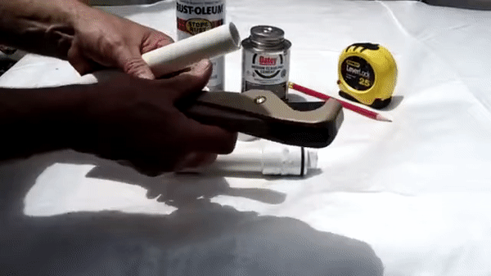
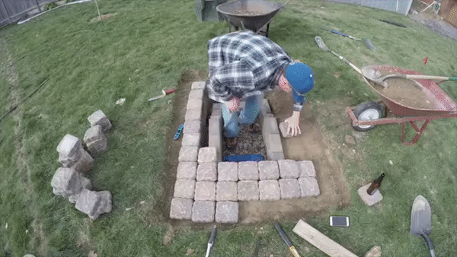
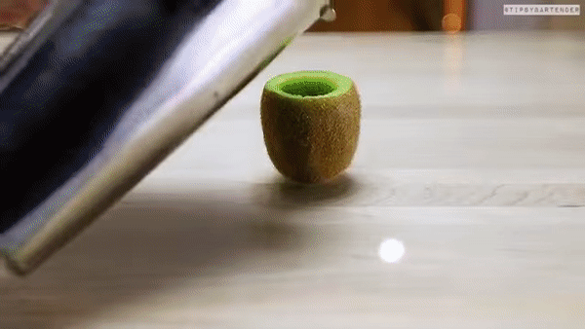
Zero-shot VideoQA: qualitative results
Question: What is the man cutting?
GT answer: pipe
QA-T (HowToVQA69M): onion
VQA-T (HowTo100M): knife holder
Ours: pipe
Question: What is the largest object at the right of the man?
GT answer: wheelbarrow
QA-T (HowToVQA69M): statue
VQA-T (HowTo100M): trowel
Ours: wheelbarrow
Question: What fruit is shown in the end?
GT answer: watermelon
QA-T (HowToVQA69M): pineapple
VQA-T (HowTo100M): slotted spoon
Ours: watermelon
Source of the examples: iVQA dataset
Notes:
Explain well

Slide 15
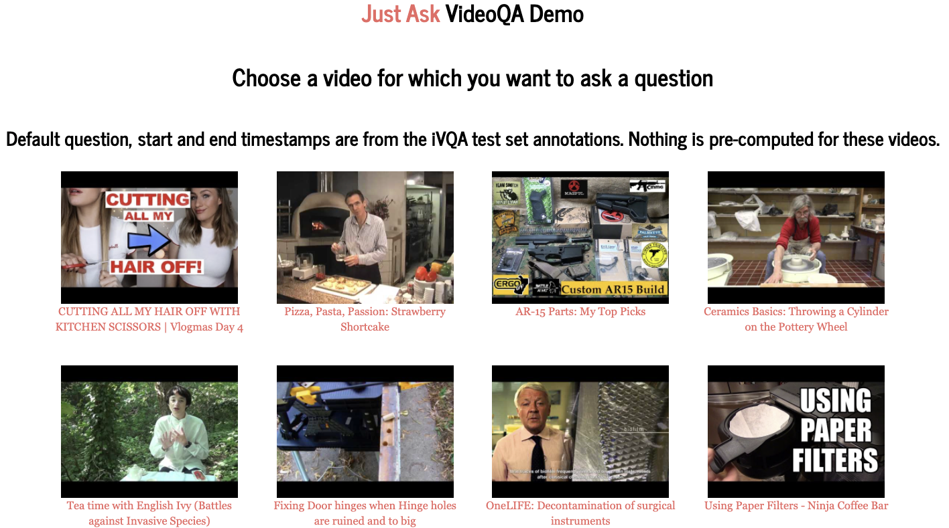
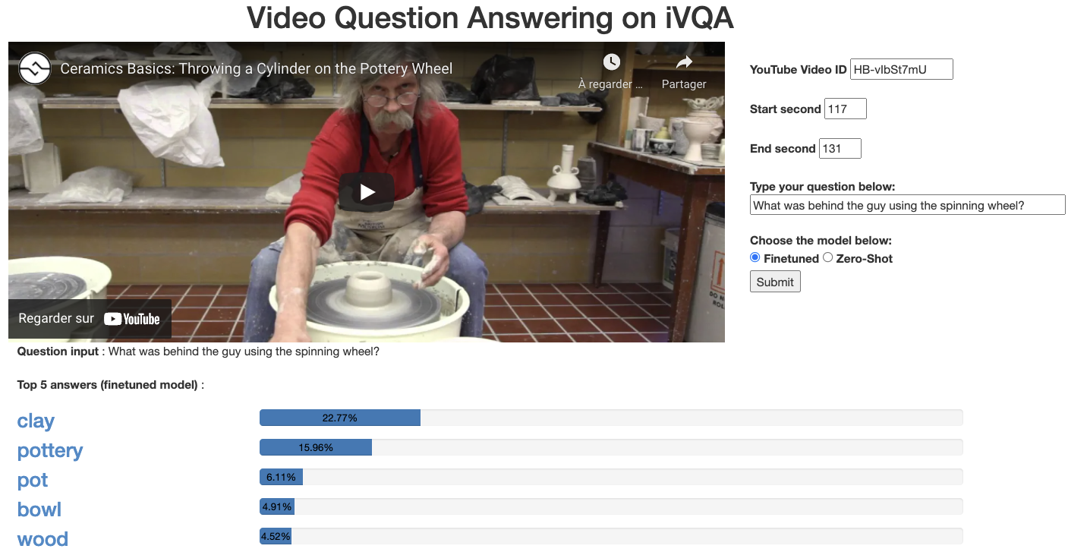
Online Demo http://videoqa.paris.inria.fr/

Slide 16
Results after finetuning
State-of-the-art results on 4 existing VideoQA datasets
Method | Pretraining Data | iVQA | MSRVTT-QA | MSVD-QA | ActivityNet-QA | How2QA
HCRN [Le 2020] | ∅ | - | 35.6 | 36.1 | - | -
SSML [Amrani 2021] | HowTo100M | - | 35.1 | 35.1 | - | -
HERO [Li 2020] | HowTo100M + TV | - | - | - | - | 74.1
ClipBERT [Lei 2021] | COCO + VG | - | 37.4 | - | - | -
CoMVT [Seo 2021] | HowTo100M | - | 39.5 | 42.6 | 38.8 | 82.3
Ours (∅) | ∅ | 23.0 | 39.6 | 41.2 | 36.8 | 80.8
Ours (HowTo100M) | HowTo100M | 28.1 | 40.4 | 43.5 | 38.1 | 81.9
Ours | HowToVQA69M | 35.4 | 41.5 | 46.3 | 38.9 | 84.4
[Le 2020] Hierarchical conditional relation networks for video question answering, Le et al, CVPR 2020.
[Amrani 2021] Noise estimation using density estimation for self-supervised multimodal learning, Amrani et al, AAAI 2021.
[Li 2020] HERO: Hierarchical encoder for video+language omni-representation pre-training, Li et al, EMNLP 2020.
[Lei 2021] Less is more: Clipbert for video-and-language learning via sparse sampling, Lei et al, CVPR 2021.
[Seo 2021] Look before you speak: Visually contextualized utterances, Seo et al, CVPR 2021.

Slide 17
Results for rare answers
Training on a downstream VideoQA dataset -> large improvements for most frequent answers
Pretraining on HowToVQA69M -> significant improvements both for common and rare answers
Results on subsets of iVQA:
Most frequent answers
Least frequent answers
Pretraining Data | Finetuning | Q1 | Q2 | Q3 | Q4
∅ | ✓ | 38.4 | 16.7 | 5.9 | 2.6
HowTo100M | ✓ | 46.7 | 22.0 | 8.6 | 3.6
HowToVQA69M | ✗ | 9.0 | 8.0 | 9.5 | 7.7
HowToVQA69M | ✓ | 47.9 | 28.1 | 15.6 | 8.5

Slide 18
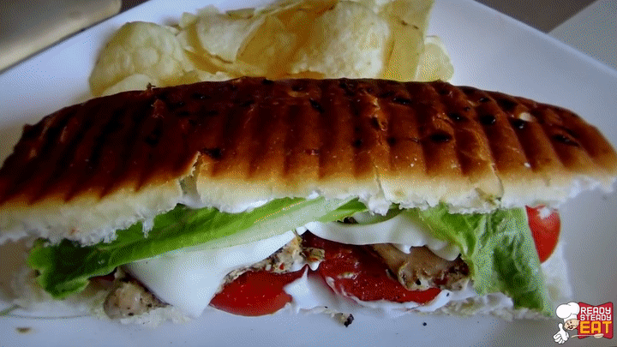
Comparison of generation methods
[Heilman 2010] was previously used to generate VideoQA data from video descriptions [Xu 2017].
We compare against [Heilman 2010] by applying it in our case.
Our generation leads to better downstream VideoQA results.
 | Zero-Shot |  |  | Finetuning
Generation method | iVQA | ActivityNet-QA | How2QA | iVQA | ActivityNet-QA | How2QA
[Heilman 2010] | 7.4 | 1.1 | 41.7 | 31.4 | 38.5 | 83.0
Ours | 12.2 | 12.2 | 51.1 | 35.4 | 38.9 | 84.4
Speech: This is classic premium chicken, grilled sandwich.
[Heilman 2010]: What is classic premium chicken, grilled sandwich? this
Ours: What type of sandwich is this? classic premium chicken, grilled sandwich
[Heilman 2010] Good question! Statistical ranking for question generation, Heilman et al, ACL 2010.
[Xu 2017] Video question answering via gradually refined attention over appearance and motion, Xu et al, ACM 2017.

Slide 19
Ablation: pretraining losses
MLM | Sampling without answer repetition | Zero-Shot |  | Finetuning
 |  | iVQA | MSVD-QA | iVQA | MSVD-QA
✗ | ✗ | 11.1 | 6.1 | 34.7 | 45.6
✗ | ✓ | 12.1 | 7.0 | 34.3 | 45.0
✓ | ✗ | 10.9 | 6.4 | 34.3 | 45.1
✓ | ✓ | 12.2 | 7.5 | 35.4 | 46.3
=> Best results with MLM and our contrastive loss
Notes:
Maybe too many messages

Slide 20
Ablation: scale
Pretraining data size | Zero-Shot |  | Finetuning
 | iVQA | MSVD-QA | iVQA | MSVD-QA
0% | - | - | 23.0 | 41.2
1% | 4.5 | 3.6 | 24.2 | 42.8
10% | 9.1 | 6.2 | 29.2 | 44.4
20% | 9.5 | 6.8 | 31.3 | 44.8
50% | 11.3 | 7.3 | 32.8 | 45.5
100% | 12.2 | 7.5 | 35.4 | 46.3
=> Scale matters.
Notes:
Maybe too many messages

Slide 21
Conclusion
We automatically generate a large-scale VideoQA dataset, HowToVQA69M, using text-only supervision and videos with readily-available narration.
We manually collect iVQA, a new VideoQA benchmark with redundant annotations and reduced language bias.
We show that our VideoQA model highly benefits from training on HowToVQA69M in a new zero-shot VideoQA setting. After finetuning, our model improves the state-of-the-art on 4 VideoQA datasets.

